Slide 1
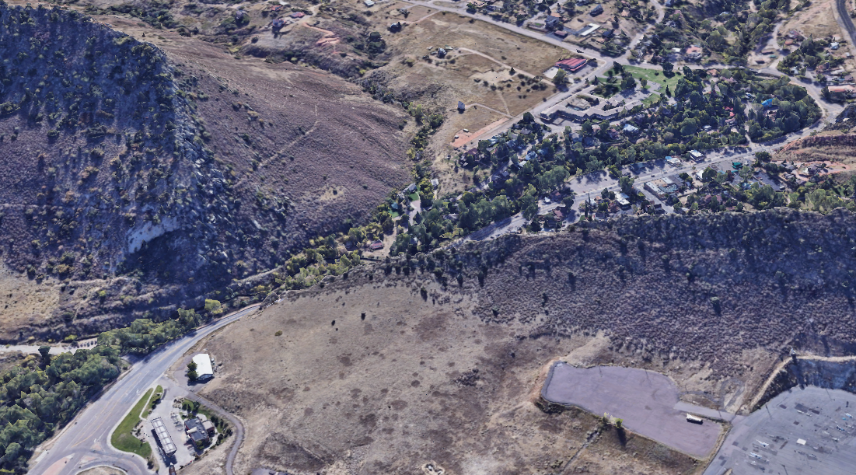

THE TOWN OF MORRISON, COLORADO
& BEAR CREEK DEVELOPMENT CORPORATION CONCEPTUAL MASTER PLAN
February 24, 2026
THE TOWN OF MORRISON & BEAR CREEK DEVELOPMENT CORPORATION

Slide 2




INTRODUCTION
Bear Creek Development Corporation
THE TOWN OF MORRISON & BEAR CREEK DEVELOPMENT CORPORATION

Slide 3
SHARED GOAL OF THE TOWN OF MORRISON AND BEAR CREEK DEVELOPMENT CORPORATION
Bear Creek engaged THK to craft a Conceptual Master Plan to implement shared goal of exploring mutual development of the BCDC and Town properties.
Development of the Conceptual Master Plan was guided by the direction in the Master Plan and Easement Agreement between the Town and Bear Creek. Accordingly, the Conceptual Master Plan package includes: an analysis of the plan's conformance with the MX-N zoning on the property; a general roadmap for the development of the Property; proposed uses for the Property; building and site design concepts; a concept infrastructure plan that includes the recommended location for the Bear Creek access road and any needed secondary access (e.g., utility and fire) that provide a direct route to and minimize the extent of disturbance on the Town Property while supporting the development proposal identified in the Conceptual Master Plan; concept pedestrian walks and trails, parks and/or open space, parking, and utilities; a pedestrian-oriented and mixed-use focus that creates a vibrant and walkable destination with parks, plazas, and public amenities; a general phasing plan; concept architectural guidelines; and a color rendering of the illustrative concept master plan.
THE TOWN OF MORRISON & BEAR CREEK DEVELOPMENT CORPORATION

Slide 4
MIXED-USE MARKET ANALYSIS
THE TOWN OF MORRISON & BEAR CREEK DEVELOPMENT CORPORATION

Slide 5
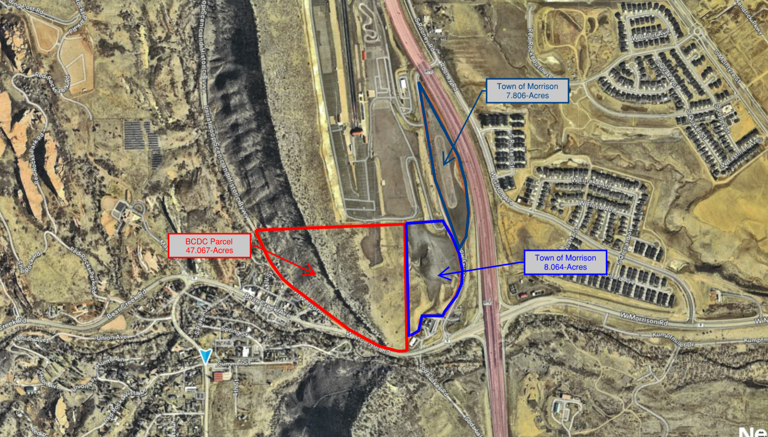
THE TOWN OF MORRISON & BEAR CREEK DEVELOPMENT CORPORATION

Slide 6
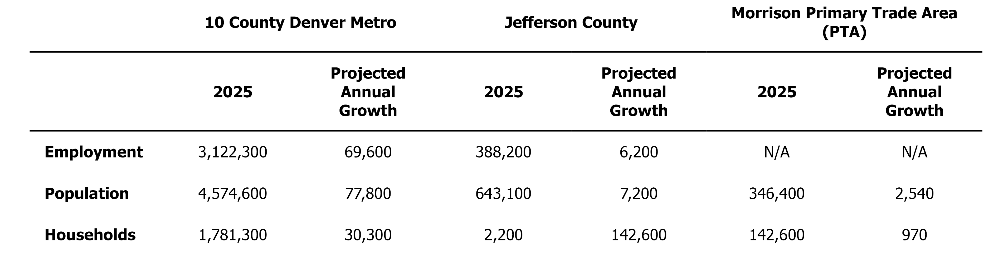
SOCIO-ECONOMIC TRENDS
250,000
2,200
THE TOWN OF MORRISON & BEAR CREEK DEVELOPMENT CORPORATION

Slide 7
TOWN OF MORRISON/BEAR CREEK DEVELOPMENT CORPORATION PRIMARY
TRADE AREA
THE TOWN OF MORRISON & BEAR CREEK DEVELOPMENT CORPORATION

Slide 8
ESTIMATED HOUSEHOLD EXPENDITURE PATTERNS
THE TOWN OF MORRISON & BEAR CREEK DEVELOPMENT CORPORATION

Slide 9
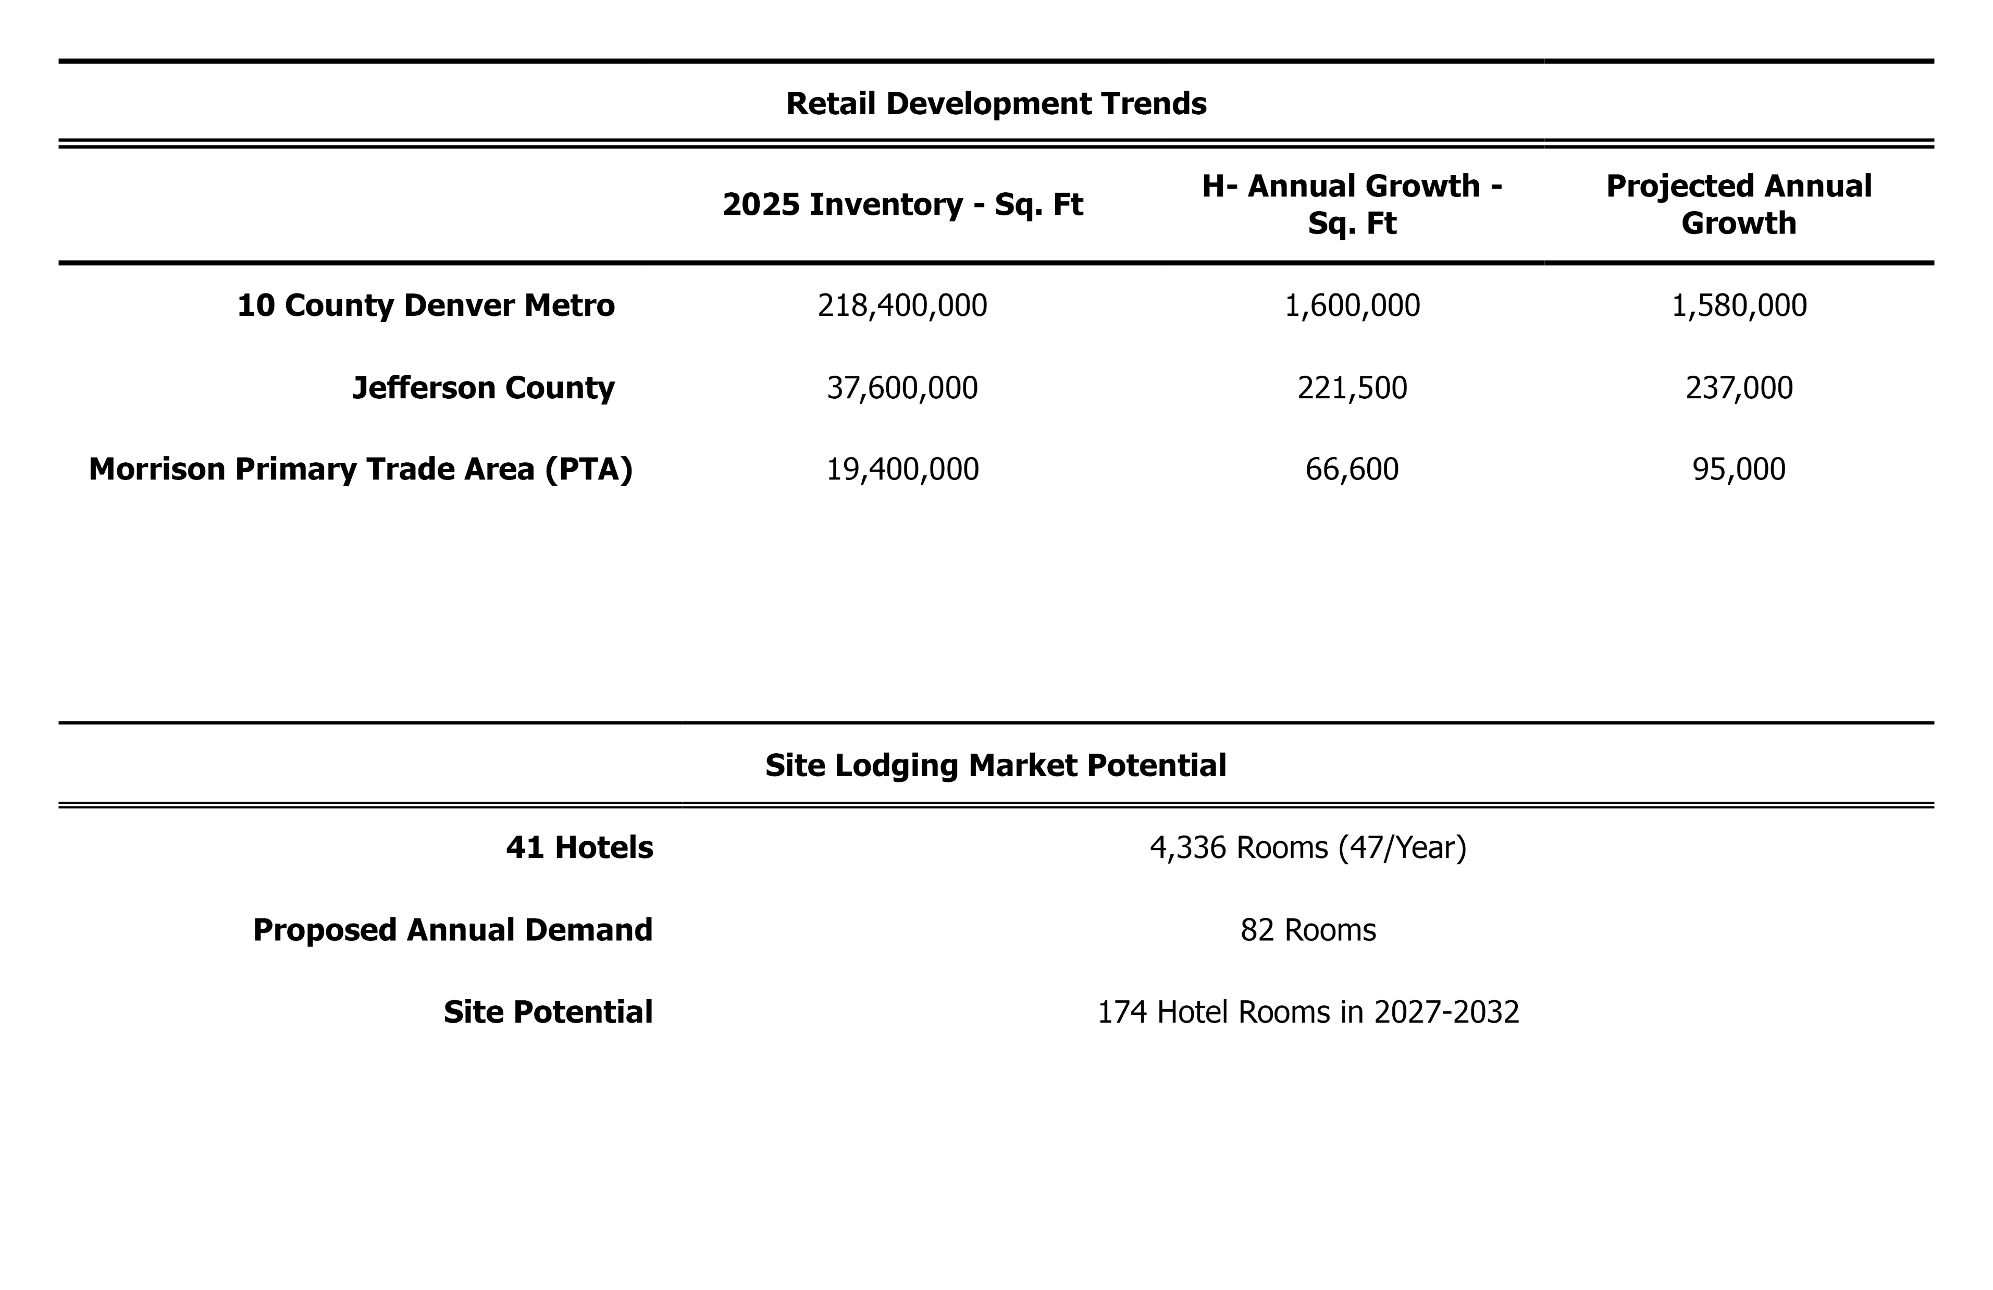
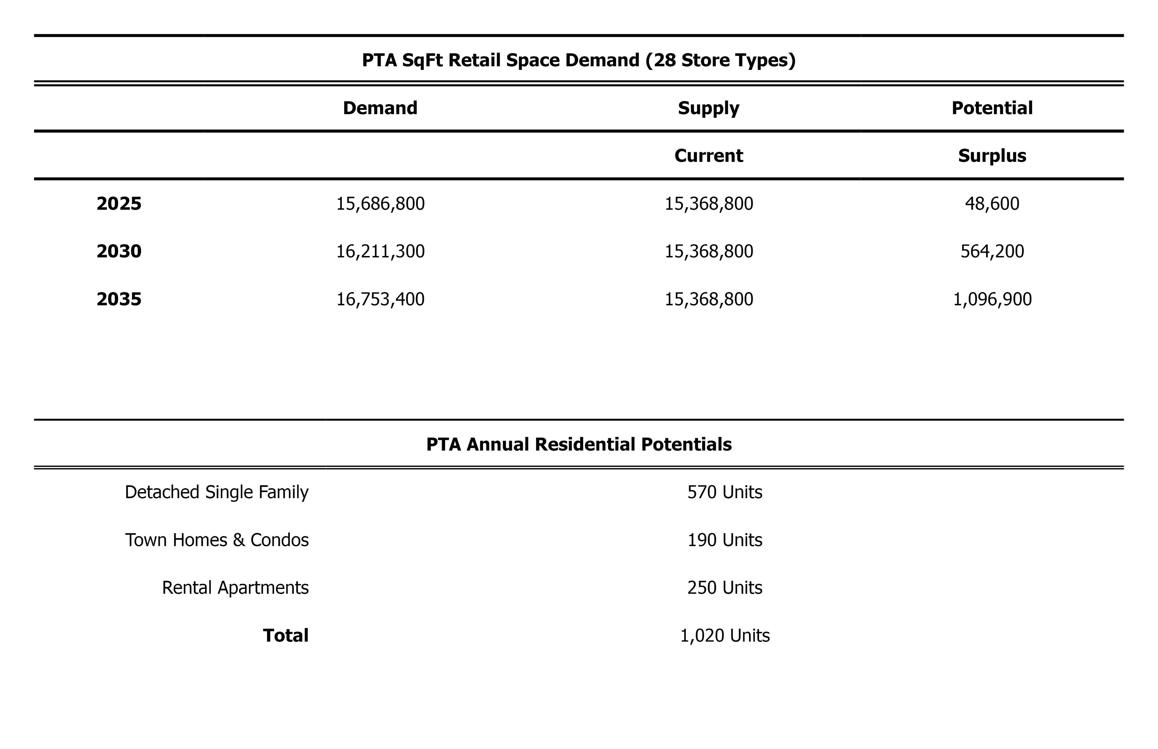
RETAIL DEVELOPMENT TRENDS
Historic Annual Growth
- Sq.Ftt
Projected Annual Growth – Sq.Ft
PTA SqFt SPACE DEMAND (28 STORE TYPES)
THE TOWN OF MORRISON & BEAR CREEK DEVELOPMENT CORPORATION

Slide 10
RECOMMENDED RETAIL COMMERCIAL USES AT THE TOWN OF MORRISON/BEAR CREEK DEVELOPMENT SITE
THE TOWN OF MORRISON & BEAR CREEK DEVELOPMENT CORPORATION

Slide 11
SITE LODGING MARKET POTENTIAL
Existing
(74/Year)
/Year
175
a
PTA ANNUAL RESIDENTIAL POTENTIALS
Townhomes
a
260
a
THE TOWN OF MORRISON & BEAR CREEK DEVELOPMENT CORPORATION

Slide 12
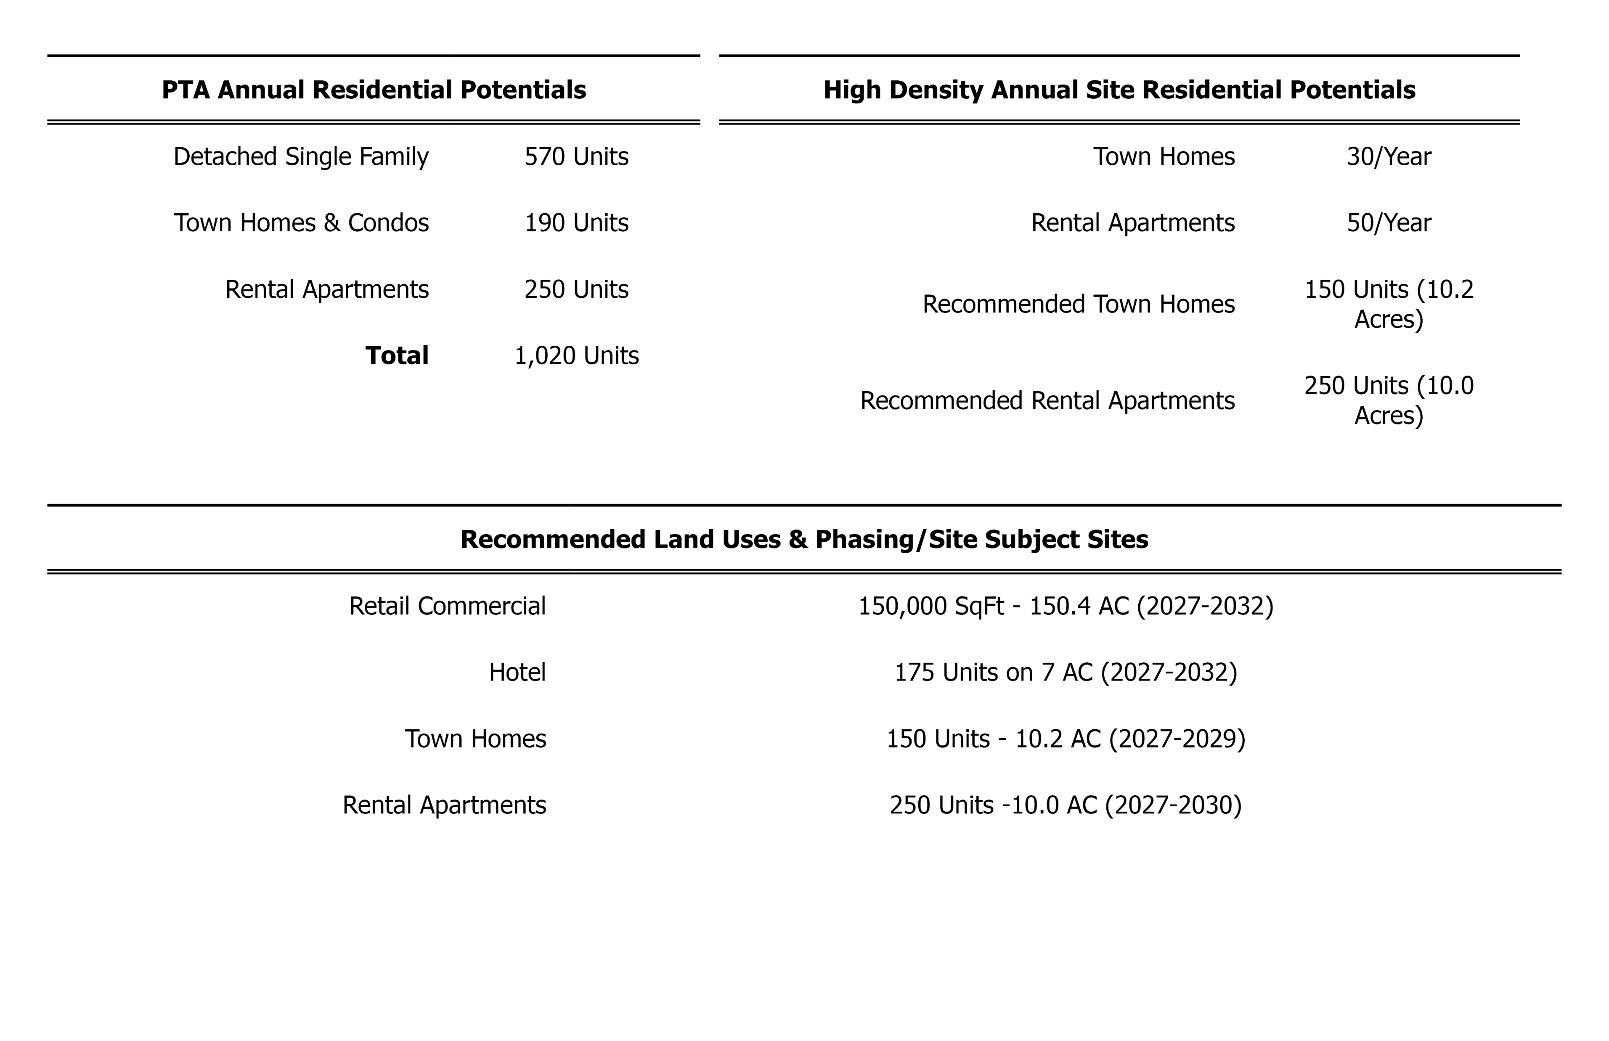
HIGH DENSITY ANNUAL SITE RESIDENTIAL POTENTIALS
Townhomes
Recommended Townhomes
THE TOWN OF MORRISON & BEAR CREEK DEVELOPMENT CORPORATION

Slide 13
RECOMMENDED LAND USES & PHASING
151,000 SqFt – 15.4 (2027-2032)
175 Rooms on 7 AC (2027-2032)
Townhomes
THE TOWN OF MORRISON & BEAR CREEK DEVELOPMENT CORPORATION

Slide 14
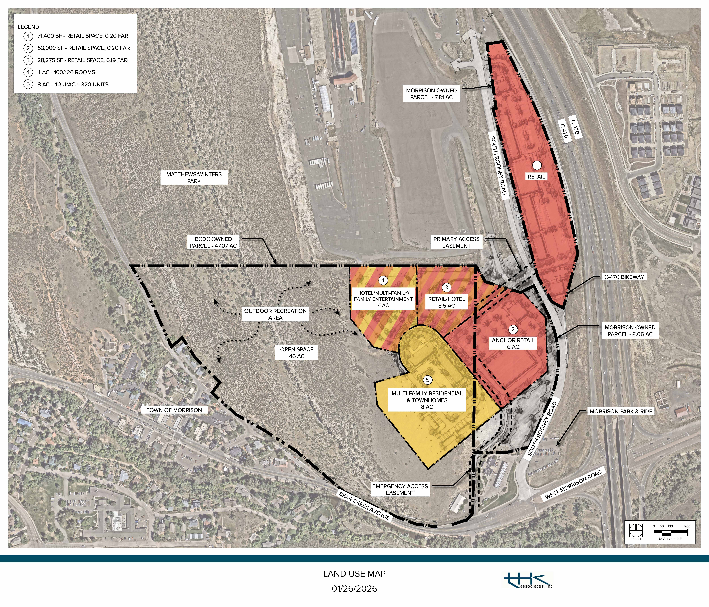
175-180 Rooms
LAND USE MAP
THE TOWN OF MORRISON & BEAR CREEK DEVELOPMENT CORPORATION

Slide 15
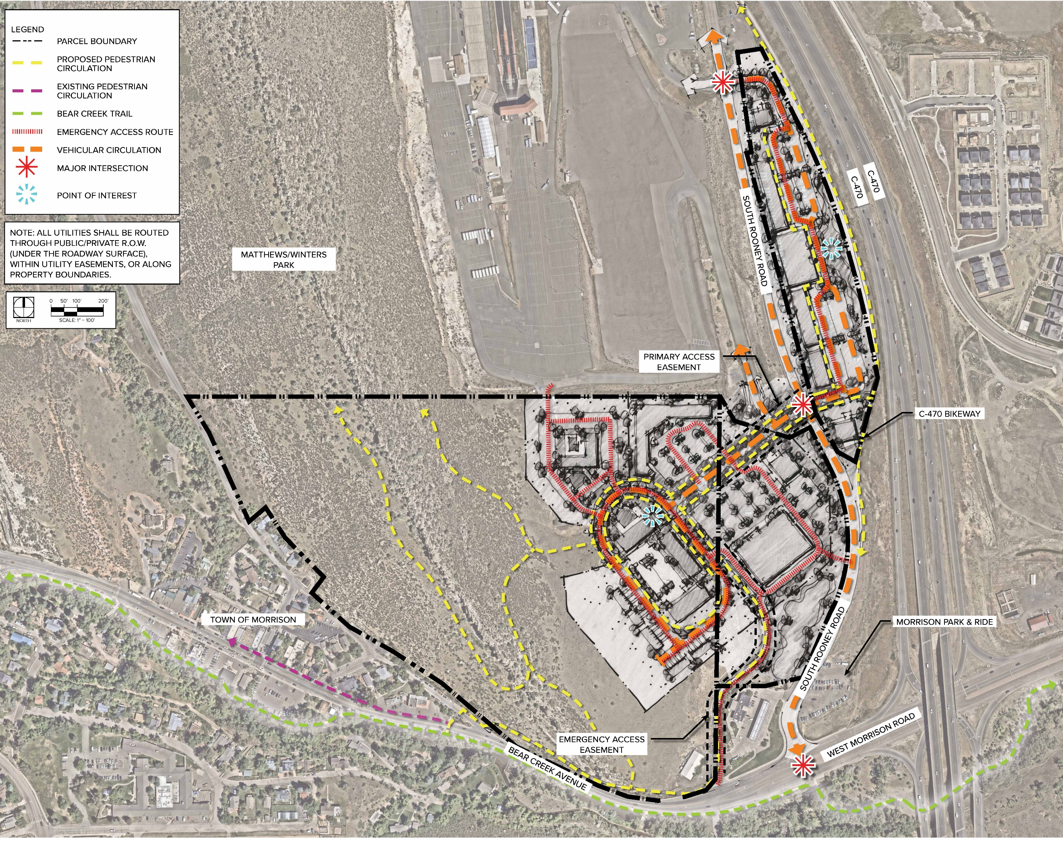
ACCESS &
CIRCULATION
THE TOWN OF MORRISON & BEAR CREEK DEVELOPMENT CORPORATION

Slide 16
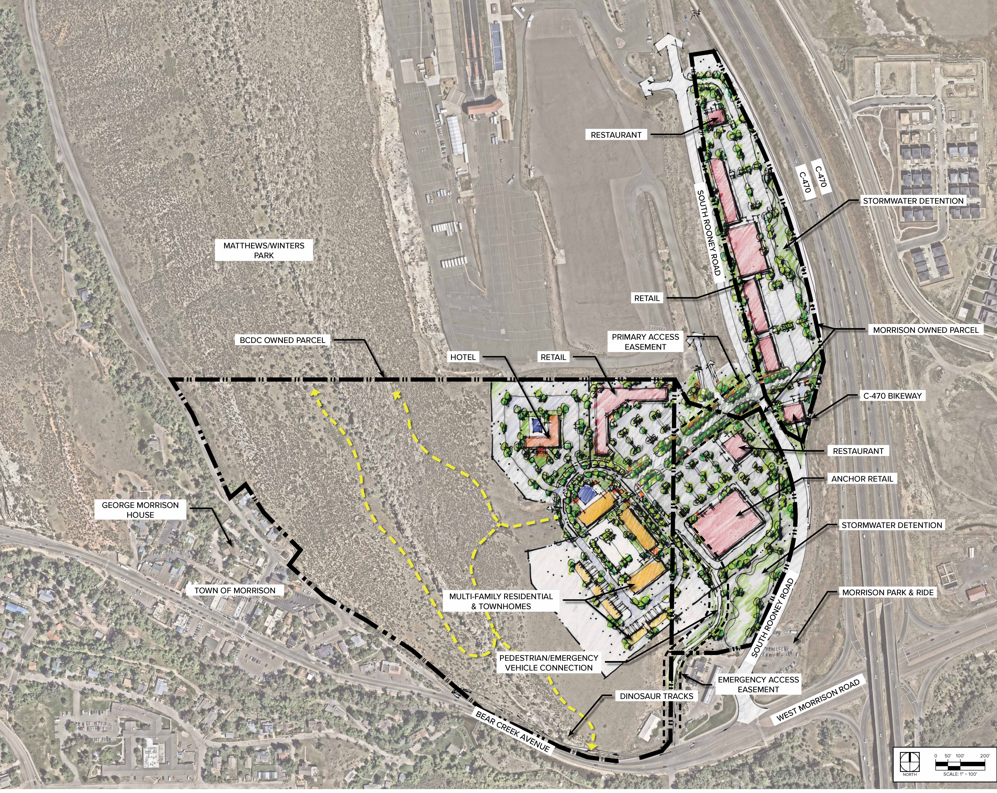
CONCEPTUAL MASTER PLAN
THE TOWN OF MORRISON & BEAR CREEK DEVELOPMENT CORPORATION

Slide 17
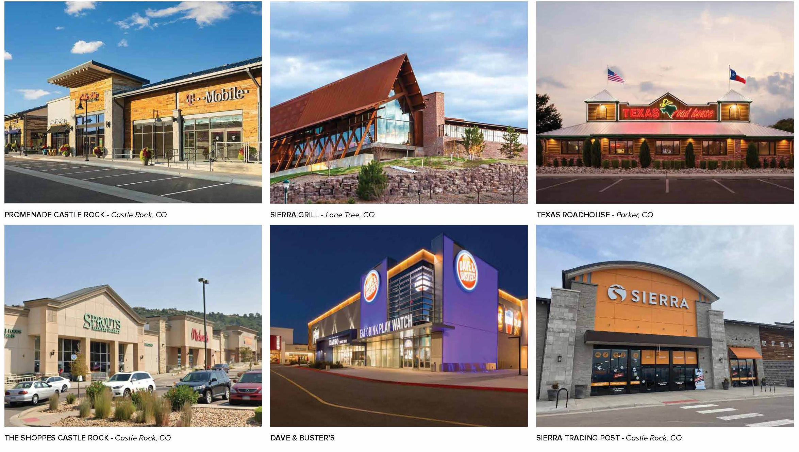
ANCHOR & IN-LINE RETAIL CONCEPTUAL ARCHITECTURAL GUIDELINES
THE TOWN OF MORRISON & BEAR CREEK DEVELOPMENT CORPORATION

Slide 18
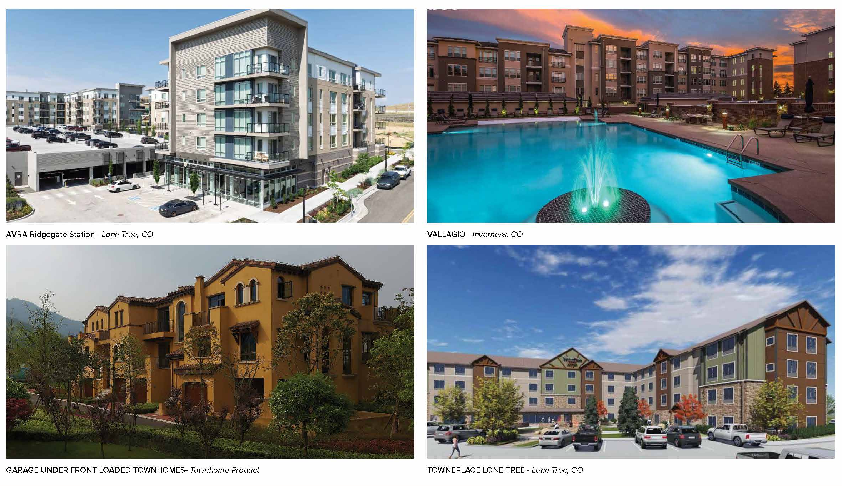
MULTI-FAMILY RESIDENTIAL & HOTEL CONCEPTUAL ARCHITECTURAL GUIDELINES
BEAR CREEK DEVELOPMENT CORPORATION & THE TOWN OF MORRISON, COLORADO

Slide 19
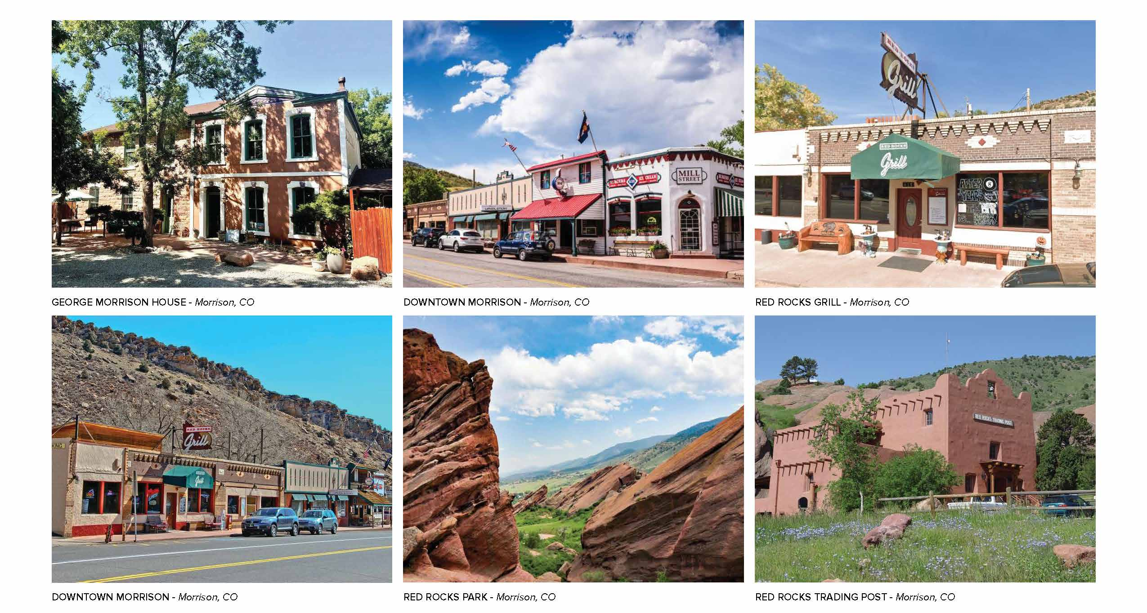
TOWN CHARACTER - ARCHITECTURAL GUIDELINES
THE TOWN OF MORRISON & BEAR CREEK DEVELOPMENT CORPORATION

Slide 20
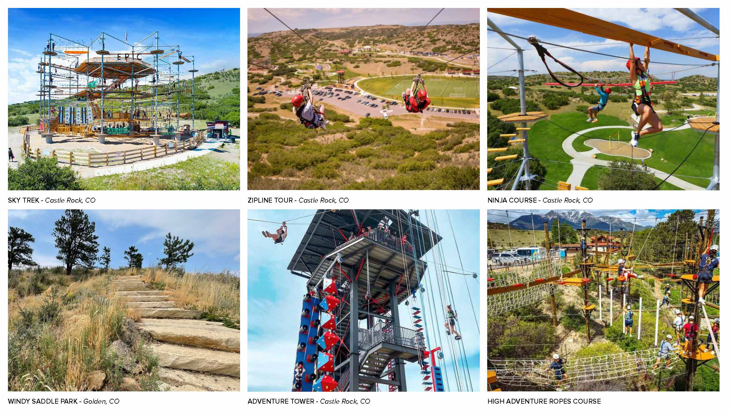
OUTDOOR RECREATION PRECEDENTS
BEAR CREEK DEVELOPMENT CORPORATION & THE TOWN OF MORRISON, COLORADO

Slide 21
LODGING FISCAL IMPACT ANALYSIS
THE TOWN OF MORRISON & BEAR CREEK DEVELOPMENT CORPORATION

Slide 22
TAXING AUTHORITIES & MILL LEVIES AT THE SUBJECT SITE
THE TOWN OF MORRISON & BEAR CREEK DEVELOPMENT CORPORATION

Slide 23
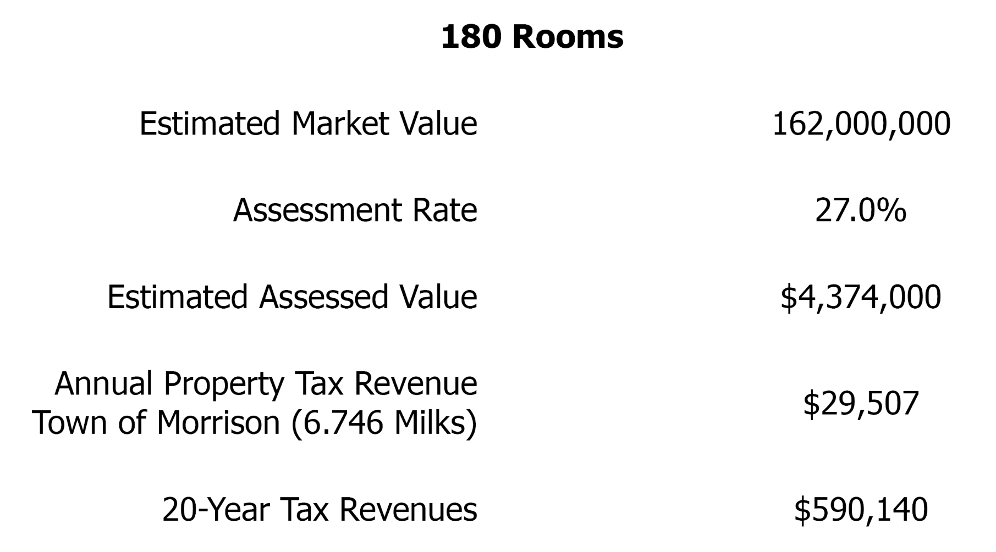
LODGING TAX REVENUES FROM THE 180 HOTEL ROOMS AT THE SUBJECT SITE
$16,200,000
s)
THE TOWN OF MORRISON & BEAR CREEK DEVELOPMENT CORPORATION

Slide 24
COMPARABLE MUNICIPAL LODGING TAX RATES
THE TOWN OF MORRISON & BEAR CREEK DEVELOPMENT CORPORATION

Slide 25
POTENTIAL SALES TAX REVENUE FROM
HOTEL DEVELOPMENT
THE TOWN OF MORRISON & BEAR CREEK DEVELOPMENT CORPORATION

Slide 26
POTENTIAL SALES TAX REVENUE FROM HOTEL RELATED PERMANENT EMPLOYEES
BEAR CREEK DEVELOPMENT CORPORATION & THE TOWN OF MORRISON, COLORADO

Slide 27
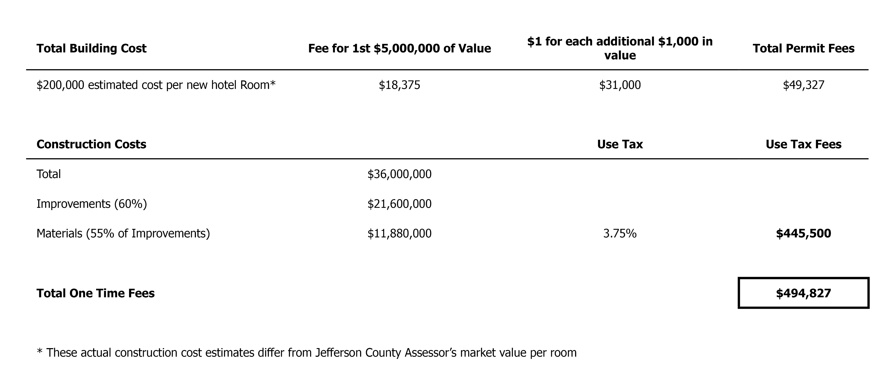
TOWN OF MORRISON LODGING BUILDING PERMIT
& USE TAX FEES
THE TOWN OF MORRISON & BEAR CREEK DEVELOPMENT CORPORATION

Slide 28
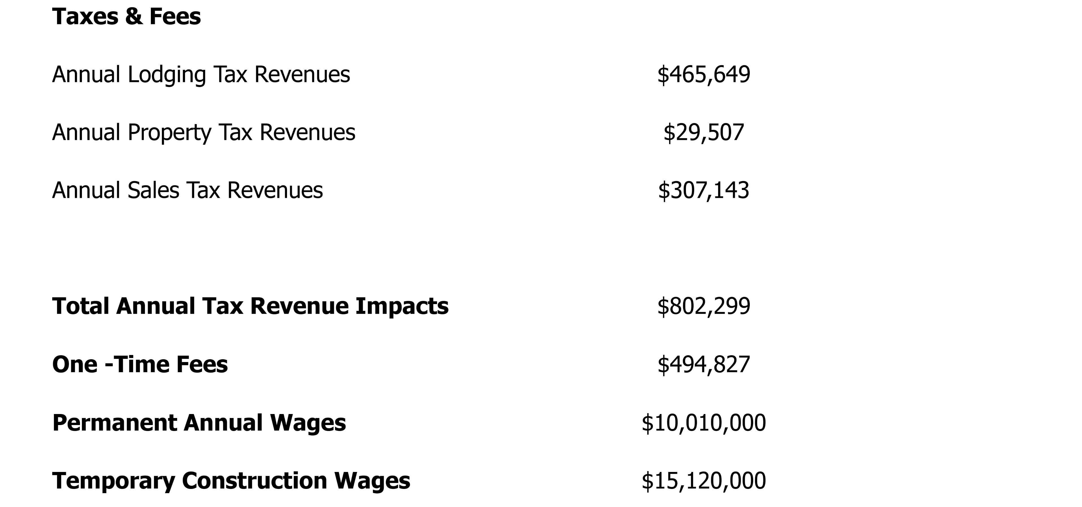
SUMMARY OF LODGING REVENUE IMPACTS
ON THE TOWN OF MORRISON
BEAR CREEK DEVELOPMENT CORPORATION & THE TOWN OF MORRISON, COLORADO

Slide 29
MIXED USE FISCAL IMPACT ANALYSIS
THE TOWN OF MORRISON & BEAR CREEK DEVELOPMENT CORPORATION

Slide 30
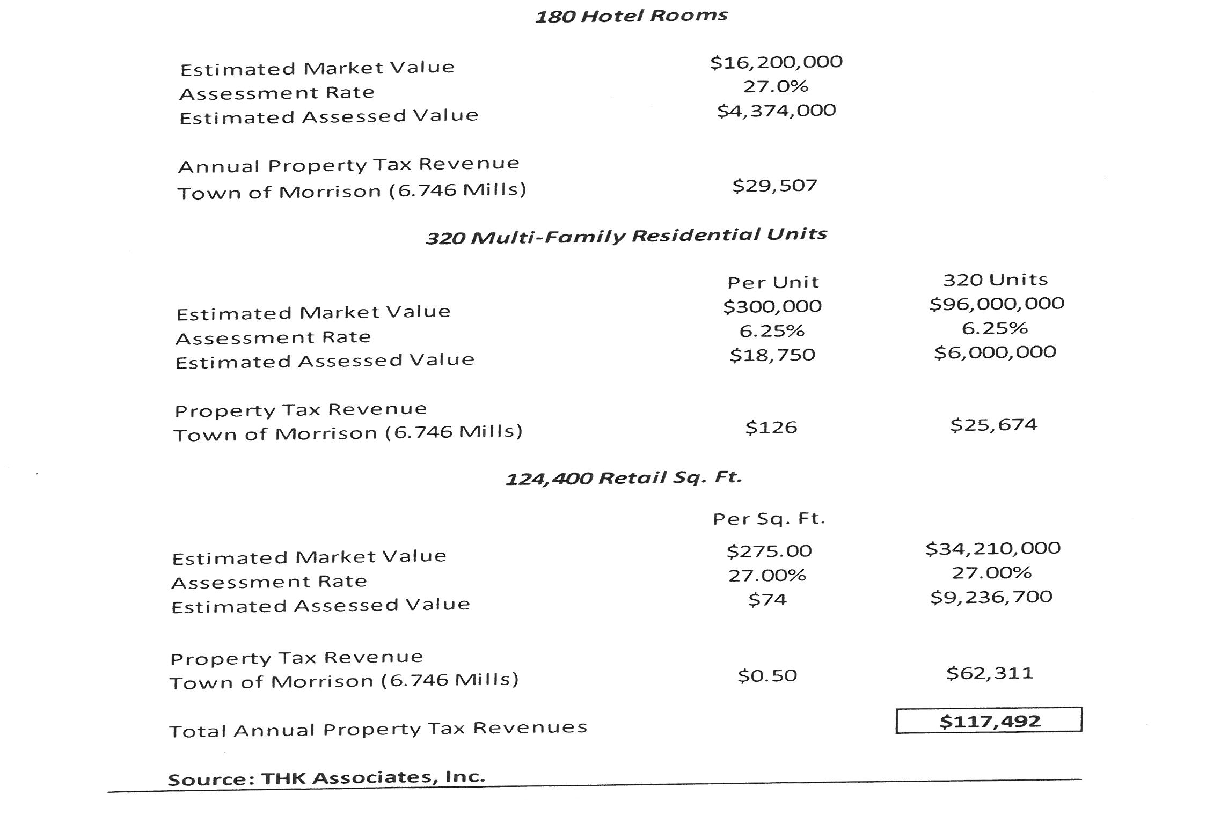
ESTIMATED PROPERTY TAX REVENUES
THE TOWN OF MORRISON & BEAR CREEK DEVELOPMENT CORPORATION

Slide 31
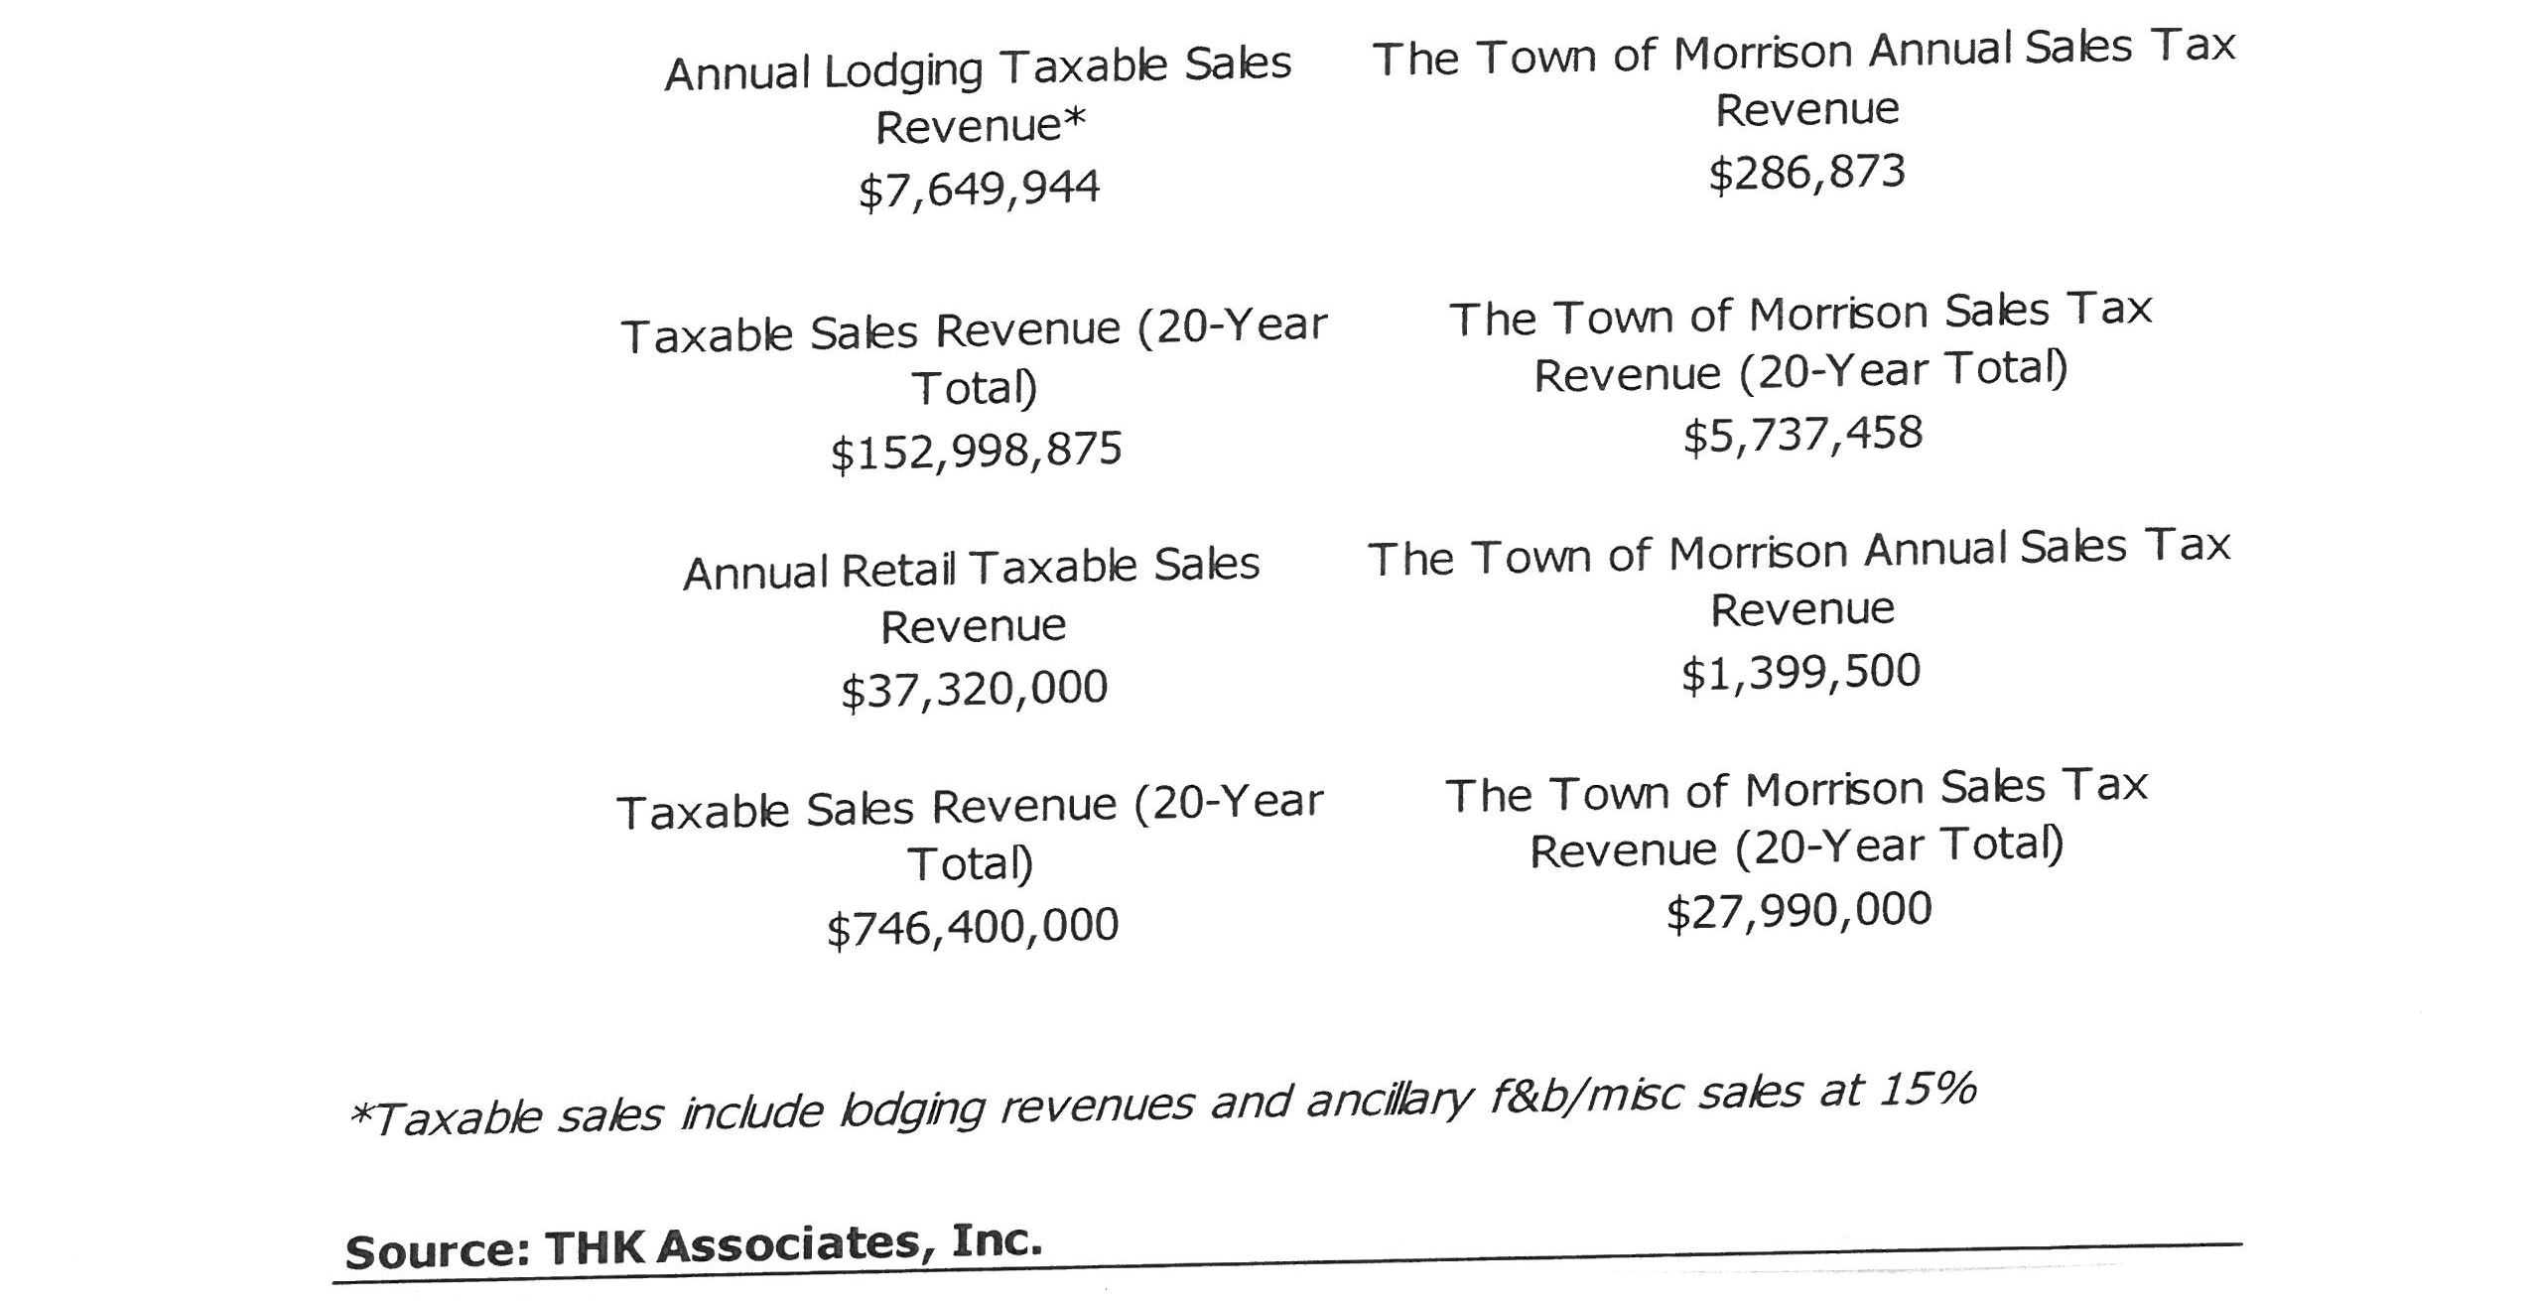
POTENTIAL SALES TAX REVENUE FROM
TOTAL DEVELOPMENT
THE TOWN OF MORRISON & BEAR CREEK DEVELOPMENT CORPORATION

Slide 32
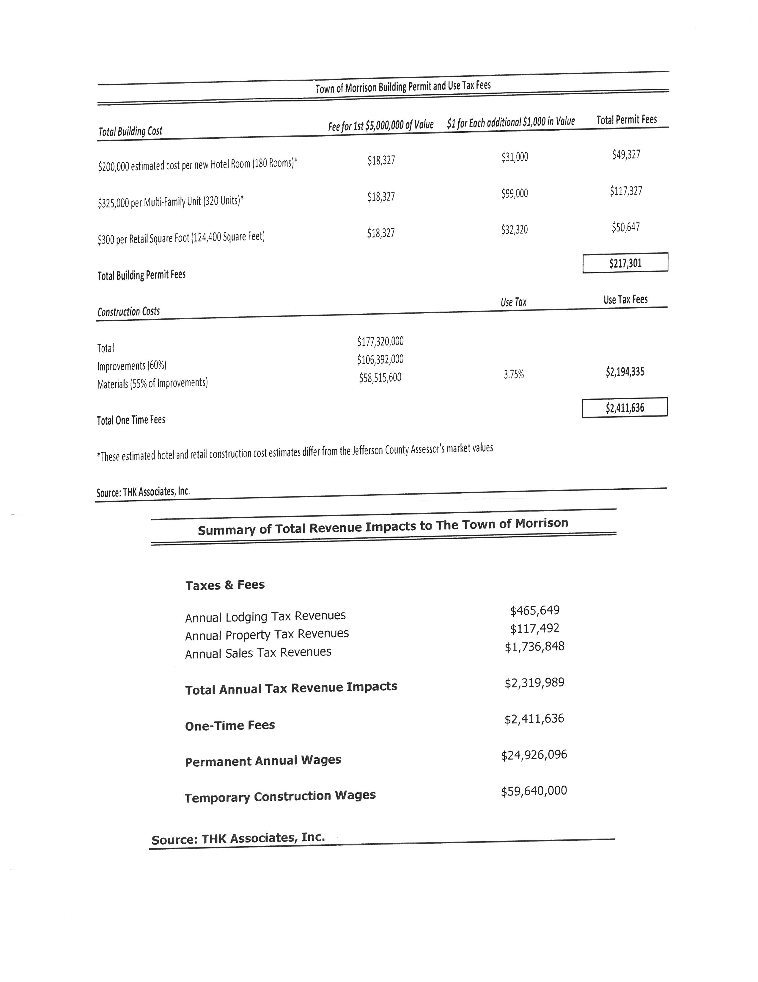
TOWN OF MORRISON BUILDING AND USE TAX FEES
THE TOWN OF MORRISON & BEAR CREEK DEVELOPMENT CORPORATION
Notes:
w

Slide 33
SUMMARY OF REVENUE IMPACTS TO THE TOWN OF MORRISON
THE TOWN OF MORRISON & BEAR CREEK DEVELOPMENT CORPORATION

